Slide 1


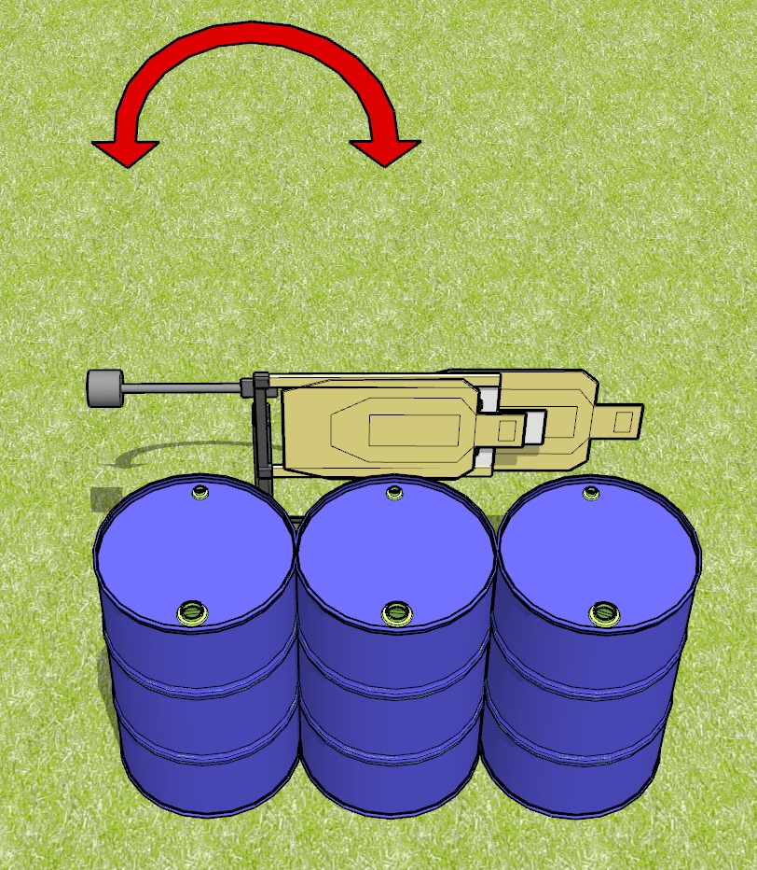
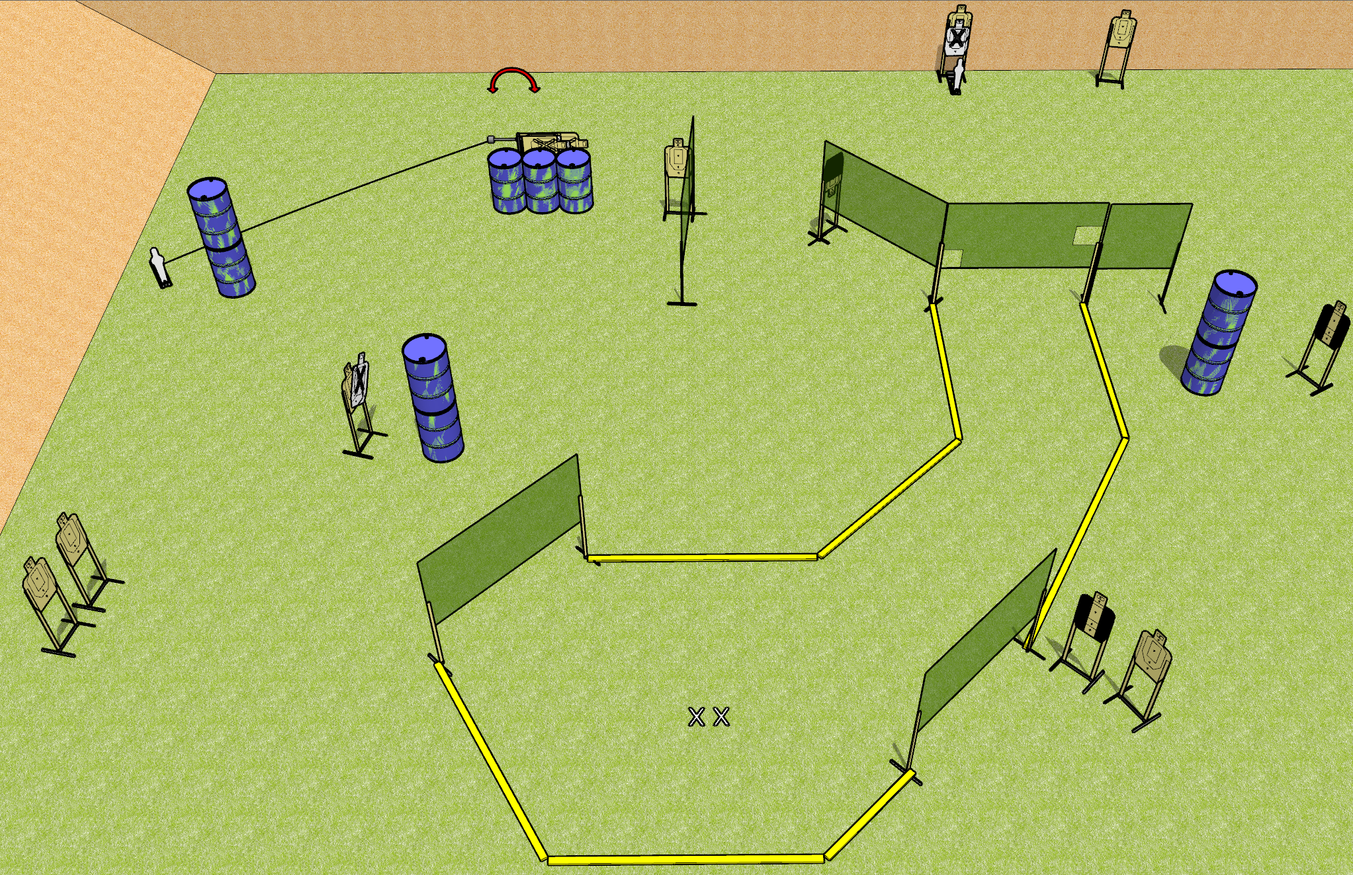
 | Dothan Gun Club – USPSA Match Soulless Course Designer : Drew Coleman
Round Count 26 Rounds 12 USPSA 2 Mini poppers
Equipment List 1 swinger 1 medium fault line 11 wall feet 2 tuxedos, 1 50%

Slide 2
Soulless
Written Stage Briefing
Soulless is a 26 round, 130 point, Comstock course of fire. There are 12 USPSA targets and 2 mini poppers. The best 2 hits on paper will score, and steel must fall to score. The start signal is audible.
The swinger is activated by the left mini popper, and is visible at rest. Please check the activator prior to walkthrough and set it the same way every time.
Handgun start position is feet on X’s, wrists below belt. Handgun is loaded and holstered.
PCC start position is feet on X’s. Loaded carbine is held with both hands, stock on belt, safety on.
On start signal, engage targets as they become available from within the shooting area.

Slide 3
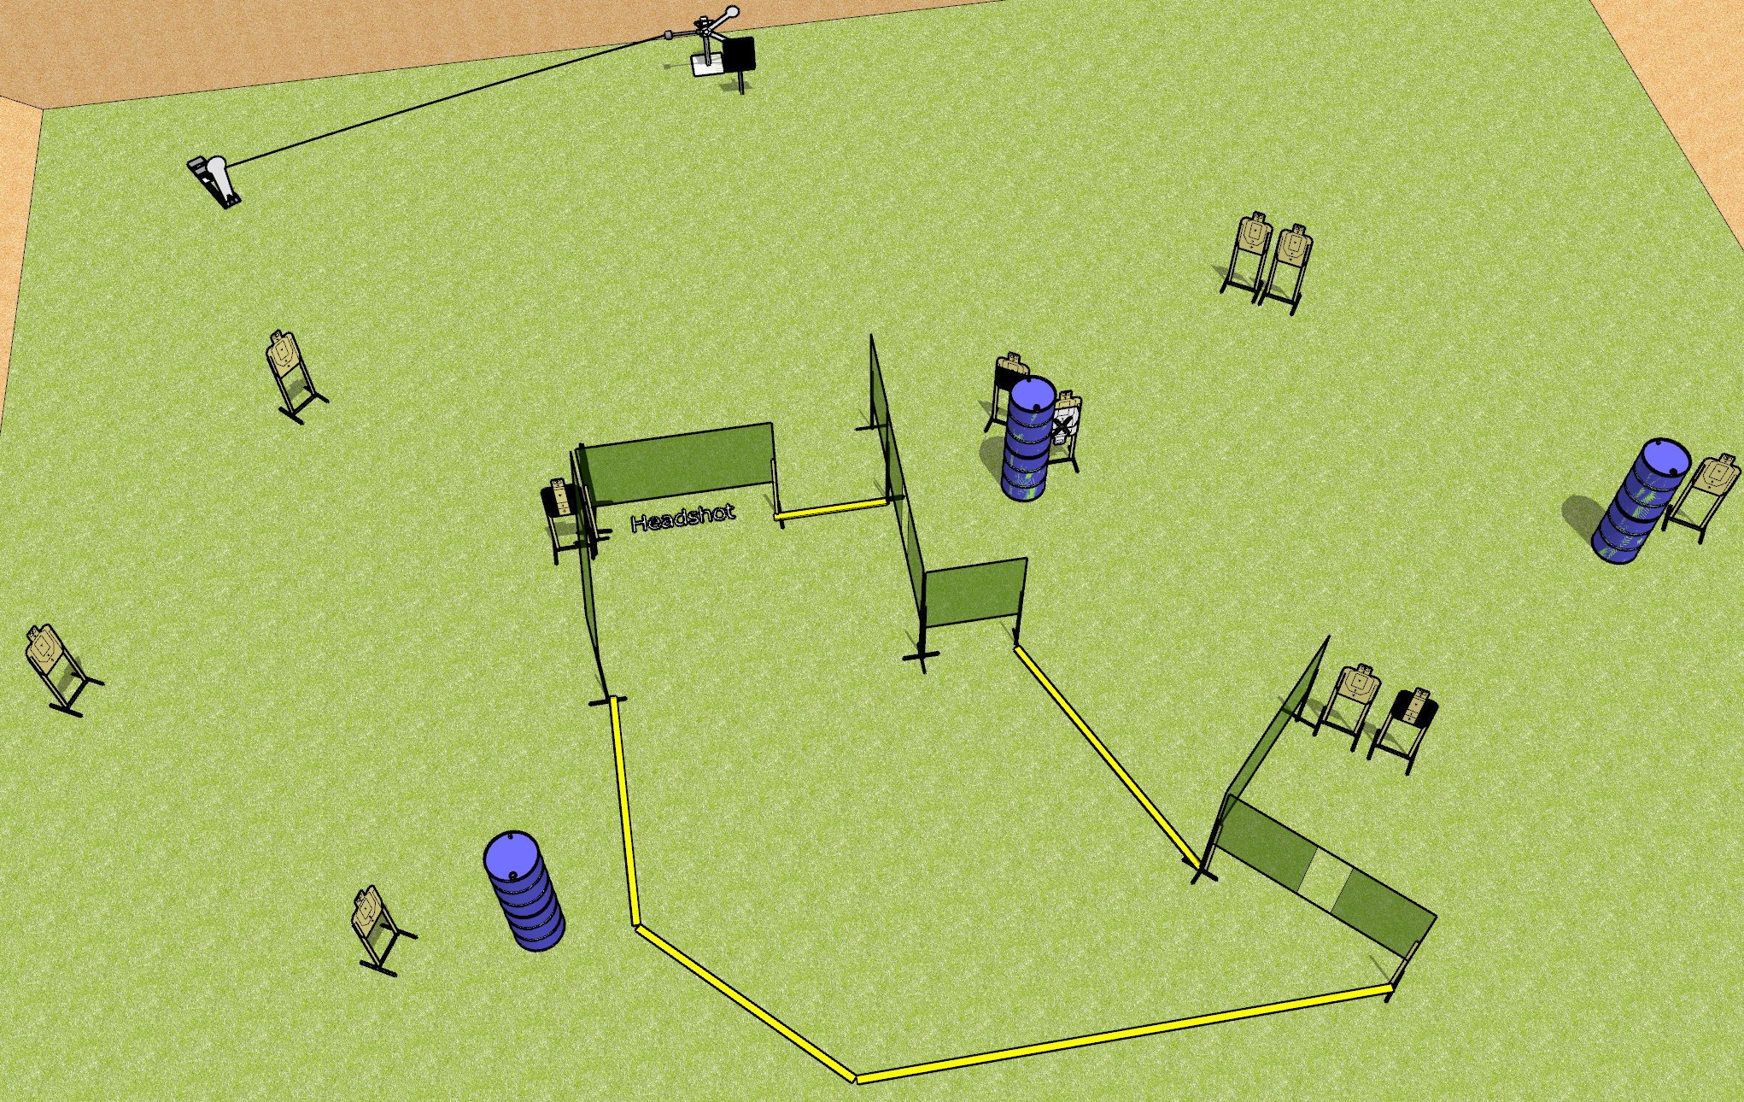
 | Dothan Gun Club – USPSA Match Taking the Mickey Course Designer : Drew Coleman
Round Count 27 rounds 12 USPSA targets 1 colt popper, 2 falling plates
Equipment List Red stitch target + steel challenge plate and stand 10 wall feet 2 medium fault lines 2 tuxedos, 1 headshot, 1 50%

Slide 4
Taking the Mickey
Written Stage Briefing
Taking the Mickey is a 27 round, 135 point, Comstock course of fire. There are 12 USPSA targets, 1 colt popper, and 2 falling plates. The best 2 hits on paper will score and steel must fall to score.
The swinging metal target is activated by the colt popper, and is visible at rest. The target must be activated before being engaged. Please check the activator prior to walkthrough, and set it the same way every time.
Handgun start position is heels against any fault line, wrists above shoulders. Handgun is loaded and holstered.
PCC start position is heels against any fault line. Loaded carbine is held with both hands, stock on belt.
On start signal, engage targets as they become available from within the shooting area.

